Slide 1

Bringing Radical Trust & Transparency to Expenses
Approvi
Expenses, Done Right.

Slide 2






Summary
Problem
Solution
Go To Market
Competition
Financials
The Team
Appendix
Expenses, Done Right.
Optimize the current expense management process
Approvi removes the need for management and financial approval of expenses while bringing radical transparency to the spend process and enabling near-instant re-payment.
Make it open and transparent
Third parties can view a transaction and attest to its validity, or protest that it occurred. This takes place as a result of Approvi facilitating the record on the Ethereum blockchain.
Reward good actors
Third parties are rewarded and encouraged to exhibit good behavior by gaining a resource called credibility, and organizations can share their good investment habits with the world.
Build a sustainable, exciting, high-growth business we’re proud of
Approvi is offering 30% equity stake for an investment of $1.3M and projects to be cash flow positive in the second year. This represents an investor IRR of 73.3% after six years.

Slide 3
Approvi
Expenses, Done Right.
Problem

Slide 4



Summary
Problem
Solution
Go To Market
Competition
Financials
The Team
Appendix
The traditional way of tracking funds and paying for expenses is archaic and broken
Who they are
Organizations want to showcase their work. These teams need to be trusted to do the right thing and are often owners themselves.
Team members want to be rewarded for good habits. They want expenses to be paid out quickly and easily.
Third parties want to see how money is being invested – whether as investors, concerned citizens, supporters of NGOs, or potential employees.
Trust & Autonomy
Experience & Speed
Transparency & Accountability
There are the six key elements missing in the expense management and approval process that apply to each of the three groups.
Approvi brings stakeholders together to bring radical transparency to spending, eliminate wasteful practices, and reward good actors.
Organizations spend resources on expense policies to manage spending. The valuable time of managers and finance approvers is wasted.
Individuals often spend on their own and must wait for reimbursement and money deposit. Their good habits can’t be transferred across organizations.
Third parties can’t see how organizations are investing resources. They can’t provide input, even when they have a clear interest in the outcome.
Problems

Slide 5
Summary
Problem
Solution
Go To Market
Competition
Financials
The Team
Appendix
The six dimensions outlined are key in understanding how Approvi will approach a solution; it is helpful to compare to the current process of expense management in organizations we are targeting
Six elements examined
Trust – Establishing a common understanding between parties who interact or are affected by transactions is currently difficult or nonexistent
Autonomy – The organizational structure is currently hierarchical and approvers are often “rubber-stamping” or have conflicting interests.
Experience – The user experience from end to end; we target to be as good or better than the current system for managing expenses.
Speed – How quickly can these expenses be processed, and the parties involved pay and be paid.
Transparency – Traditional systems do not enable third parties to review transactions for authenticity or compliance.
Accountability – The individuals ultimately spending money on an organization’s behalf are not currently held accountable for how their money is being spent, except by their manager or finance team.
1
2
3
4
5
6

Slide 6







Summary
Problem
Solution
Go To Market
Competition
Financials
The Team
Appendix
An Ethereum-based solution targeted at public institutions that enables better governance mechanisms, fiscal transparency, and an ability for the public to actively engage in helping them through attestations
Challenges facing public institutions that are seeking an urgent solution
Poor Governance: Most Non-Profits and Open Source Initiatives lack effective governance and networking efforts that could help them.
Lack of Funds: Perpetual lack of sufficient, appropriate and continuous funds along with need of existing contributors/donors on higher visibility of funds spent.
Limited Capacity: Many non-profits and open source initiatives have limited technical and organizational capacity to be spent on tasks which maybe outside their core domain.
Why Ethereum ?
Multiple Entities Contributing to the Data Source
Organizations seeking to serve a public purpose often struggle with giving external stakeholders both an opportunity to observe and take an active part in their functioning.
A blockchain based solution solves this need of multiple internal and external stakeholders actively engaging in the process of authentication and tracking of expenses.
Tamper Proof Log of Data
Decentralized Data Storage
Autonomous Governance Mechanisms
“Greater Authenticity not just more Transparency.”
- Charity Commission for England and Wales

Slide 7








Summary
Problem
Solution
Go To Market
Competition
Financials
The Team
Appendix
There are certain organizations who will benefit most from this increased trust and autonomy; our hypothesis is that non-profits will be most receptive, given their organizational charters often require it and donors should support it
First Phase
Not-for-profits
Not-for profits often struggle to convey the impact of their dollars to potential donors. They also need to meet the rigorous demands of government grants, which adds administrative costs and difficulties securing revenue for continuing operations.
Open source contributors are compensated sporadically for their efforts, however against the spirit of open source, the compensation is often opaque, not intentionally, but by the nature of legacy payment systems.
Next Steps
Open Source Projects
Freelancer networks contain individuals who often work on an hourly or contractual basis and operate in countries with multiple currencies, bringing complicated and costly intermediaries into the process as a patchwork fix.
Public universities receive funding and grants from the people they serve, who are often donating funds to causes they want to see supported, but there is no clear way of tracking the funds.
Governments run projects that serve municipal and state communities, but often the bidding process is opaque. Beneficiaries of the project are often unable to see how funds have been disbursed over time. In a similar vein, they cannot help contribute to projects they feel passionate about if there is a lack of funding.
Public goods such as infrastructure and health services should spend in ways that are supportive to their customers, however much of this information is not available and expenses can often be far higher than is reasonable.
The current Approvi MVP is well-positioned for initial testing and customer feedback for organizations in the non-profit and open source space.
We believe the opportunities with non-profits in a beta environment, as well as helping manage expenses for open source communities will give us the learnings necessary to move into adjacent spaces where public interest is at stake.
Freelancer Networks
Universities
Government Projects
Public Goods & Services

Slide 8
Approvi
Expenses, Done Right.
Our Solution

Slide 9






Summary
Problem
Solution
Go To Market
Competition
Financials
The Team
Appendix
Approvi removes archaic approval layers, adds transparency to expenses, and provides near-instant payment to users through our credibility layer
The Participants in an Approvi Expense Event
Spender – The initiator of the expense, who often spends on behalf of an organization which reimburses him/her.
Reimbursing Party – The organization recognizing the expense.
Third Parties – Additional participants who choose to monitor expenses, and either “attest” or “protest” them, according to the contextual validity of the expense.
Ethereum Blockchain – Used as a record of the transaction initiation and approval
Credibility – The crux of our system for expenses outside of an auto-approval threshold, participants are rewarded credibility for good behavior and monitoring whether expenses are within reason or not, by “attesting” or “protesting”.
Stablecoin – Used to facilitate value transfer between the Reimbursing Party and the Spender (USDC or DAI).
Reimbursing party defined by spender (who is reimbursing or paying)
Expense approved automatically and recorded on the blockchain if within preset guidelines and paid out from spending party via stablecoin
Expense reviewed by third parties for additional verification if required by preset guidelines
Expense approved and recorded on the blockchain, with reimbursement from spending party taking place via stablecoin
Expense event initiated by spender, who gains or loses credibility based on the attestations or protests of parties involved
Hash Function
7101349d46b60cccf75ed51cd2b496890d36d58b178ef50d0960fd748bd1ff99
Hash Function
4c4f701e82cab8dfdd989c04c2db2e43061fa161494ca45c356d9dd6b6883b59
Spender (Wallet B)
Spender (Wallet B)
Credibility Awarded
Reimbursing Party (Wallet A)
Reimbursing Party (Wallet A)
Approved & Paid
Location (receipt OCR scan)
Location (receipt OCR scan)
Date & Time (receipt OCR scan)
Date & Time (receipt OCR scan)
An expense is automatically approved if it falls below a pre-defined dollar amount, or location and time of expense can be verified using the Approvi OCR capture & meta data.
Expense Amount (manual entry or OCR)
Expense Amount (manual entry or OCR)
Location (receipt image metadata)
Location (receipt image metadata)
Date & Time (receipt image metadata)
Date & Time (receipt image metadata)
if (Credibility < threshold);
then (reject approval request);
and (return request to spender);
Credibility (Attestations/Protests)

Slide 10
Summary
Problem
Solution
Go To Market
Competition
Financials
The Team
Appendix
Approvi creates value for organizations in multiple areas – from modernizing legacy accounting systems to disintermediating the hierarchical approval processes that are in place to govern expense management
Upload Spend Receipts
Receive Reimbursement
Attest or Protest Expenses
Hash
7101349d46b60cccf75ed51cd2b496890d36d58b178ef50d0960fd748bd1ff99
Hash
4c4f701e82cab8dfdd989c04c2db2e43061fa161494ca45c356d9dd6b6883b59
Spender (Wallet B)
Spender (Wallet B)
Reimbursing Party (Wallet A)
Reimbursing Party (Wallet A)
Location (receipt OCR scan)
Location (receipt OCR scan)
Date & Time (receipt OCR scan)
Date & Time (receipt OCR scan)
Expense Amount (manual entry or OCR)
Expense Amount (manual entry or OCR)
Location (receipt image metadata)
Location (receipt image metadata)
Date & Time (receipt image metadata)
Date & Time (receipt image metadata)
Credibility (Attestations/Protests)

Slide 11
Summary
Problem
Solution
Go To Market
Competition
Financials
The Team
Appendix
Approvi will be integrated with multiple services to bring a seamless customer experience to our users
Payment Services
Identity Services
Wallet Services

Slide 12
Approvi
Expenses, Done Right.
Go To Market

Slide 13

Summary
Problem
Solution
Go To Market
Competition
Financials
The Team
Appendix
The global travel and expense management software market size will grow by USD 2.49 billion during 2019-2023. In order to enter in, specific risks and challenges must be considered
Strong key market drivers
Moderate barriers to entry
Rising need to automates and streamlines employee expenses efficiently with reduced errors and lowered costs
Need for employees to conveniently generate expense reports and faster reimbursements
Rising adoption of expense management software integrated with mobile apps
Moderately fragmented market with diverses players
Companies focusing on using advanced technologies such as AI and analytics to offer high-quality solutions.
SaaS-based deployment segment will account for the highest market share due to the growing adoption of SaaS-based deployment of expense management software in SMEs
A fast growing market
Diversity of competitors
A 2019 year-over-year growth rate expected 11%
A fast growing market with a CAGR of close to 12% during the forecast period
35% of market growth will come from APAC
From legacy systems using cards and manual entry to several blockchain-based payment systems
Highly competitive landscape with several companies including Certify, Chrome River Technologies, Expensify, Infor and SAP
Source: Global Travel and Expense Management Software Market, Technavio

Slide 14








Summary
Problem
Solution
Go To Market
Competition
Financials
The Team
Appendix
First Phase
Market segmentation – User Personas are based on the perception of non-profits and open source networks
Next Steps
Blockchain Technology Adoption Traits
Organization is still on legacy systems but may be using more advanced applications like Expensify or Brex.
There are no identified champions with decision-making or approval authority.
Current systems are sticky and entrenched; changing costs appear high while willingness to change appears low.
Organization is looking to adopt new business processes including blockchain/DLT, and may have completed a PoC in the past.
There is at least one champion for the technology who require little or no education.
Current systems seem to work pretty well and match the organizational culture.
Dappy
Mappy
Happy
Organization “gets” blockchain technology and use cases and may have moved a project to production.
There are multiple champions for the technology who require little or no education.
Friction exists within current systems due to geographies, business processes, or culture.
Target Segments
Early Days
Rollercoaster
Trailblazer
Walk-then-Run
Old School
Early Adopter
These are small startups who are still discovering themselves.
Good for networking and brainstorming, but not for sales.
These companies may not be around in a year or two – things are crazy right now.
Could be considered qualified sales leads upon greater observation.
They have a sincere desire to make the world a better place.
They consider themselves to be defining a new market, using new approaches.
The leadership team references Elon Musk, Jack Ma, Jeff Bezos, or their companies.
These companies want to see someone else do it first.
The management team likes to say things like, “no one ever got fired for picking IBM”.
These companies might have implemented an ERP system and still have bad memories from it.
There are a number of employees who type only with their index fingers.
Adapted from
https://hackernoon.com/meet-mappy-happy-and-dappy-personas-for-blockchain-product-management-895bfebad94b

Slide 15






Summary
Problem
Solution
Go To Market
Competition
Financials
The Team
Appendix
Bringing it together – what is the opportunity in year 1?
Not-for-profits
Freelancer Networks
Open-source Projects
Size of Market Considerations
Organizations including non-profits, freelancer networks, and open source projects.
Teams who are open to utilizing blockchain technology to solve business problems
Organizations must be defined as “Trailblazers” in their category, or have leadership that could be described as such.
We estimate >1,500,000 qualified organizations in the US (currently disregarding other geographies)
We estimate at least 15% of these can be considered “Trailblazers”
We estimate 10% of these groups are presently either “Happy” or “Dappy”
Current size of the market is approximately 22,500 organizations in the US.
1,500,000
Initial Market Geography & Execution
Due to the global nature of our clients and target customers, we believe it is likely that we will be able to work with organizations remotely from around the world.
The majority of Approvi’s initial target customer base would be in the US.
Approvi will develop its team initially in HK, taking advantage of the strong FinTech talent in the Greater Bay Area comprising Hong Kong and Shenzhen.
Trailblazer
15%
Happy
Dappy
10%
22,500

Slide 16
Summary
Problem
Solution
Go To Market
Competition
Financials
The Team
Appendix
Approvi has implementation plans over the next 18 months with a product roadmap that will position us for success in the marketplace
2019
2020
Q1
Q2
Q3
Q4
Q5
Q6
Proof of Concept MVP
Stablecoin Payments
MVP
Product Launch
Spend Dashboards
Additional Coins
Support
User Migrations MVP
⍺ Testing
β Testing
A/B Testing
Attest Analytics
Secondary Go-To
Market Entry
Advanced Analytics
Ethereum
Testnet Runs
Ethereum
Mainnet Runs
Initial Go-To Market
1,000 Active
User Organizations
1,500 Active
User Organizations
Integration with
Fiat Payments
UI/UX Improvements
Dapp Media Marketing
Additional Billing Models
External Payments API
External Spend API
Solution Core
Business Development
Solution Enhancements
External Integrations

Slide 17
Approvi
Expenses, Done Right.
Competition

Slide 18










Summary
Problem
Solution
Go To Market
Competition
Financials
The Team
Appendix
Approvi is an innovative disruptor providing a unique solution to legacy systems and a superior solution to newer blockchain applications
Trust
Autonomy
Experience
Speed
Transparency
Accountability
Cost
Complete Solution
No Solution
Legacy Systems using cards and manual entry for submission and approval of expenses lack transparency.
The accounting systems they integrate with requires constant audit and could be subject to tampering.
Organizations and the individuals using these systems do not have full trust in one another.
Axpire
There are several blockchain-based payment systems available, however they do not fully solve the approval layer issue.
These systems are also not structured for full transparency into organizational spend patterns and third party attestations.
Request

Slide 19






Summary
Problem
Solution
Go To Market
Competition
Financials
The Team
Appendix
Approvi’s key value propositions of speed of transaction processing and transparency are far beyond the competition
Fast
Opaque
Transparent
Slow

Slide 20


Summary
Problem
Solution
Go To Market
Competition
Financials
The Team
Appendix
Our platform saves time for both management approvers & finance managers, ultimately reducing cost for companies
Average Expense Processing
Time
Submission
Approval
Reimbursement
Reporting
Total
Other Expense Software
5-10 days
1-5 days
20 days
1-5 days
1-5 days
Approvi
1 day
0-1 day
4 days
1 day
0-1 day
One platform, one UX, one secured set of data
Seamless, simple, cost-effective, digital, secured

Slide 21
Approvi
Expenses, Done Right.
Financials

Slide 22
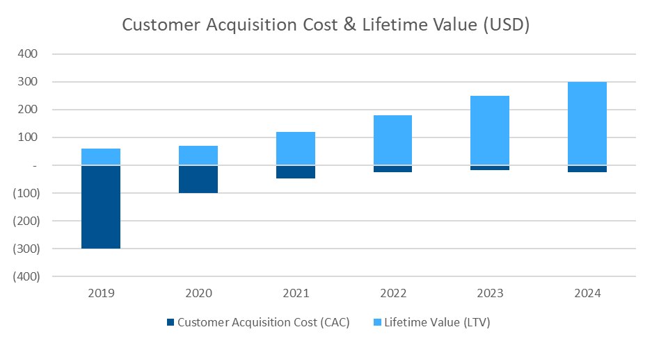
Summary
Problem
Solution
Go To Market
Competition
Financials
The Team
Appendix
Approvi generates revenue through a subscription model paid for by organizations that wish to showcase their spending habits. Over time, we plan to introduce more features and value to justify a higher monthly fee.
Customer Acquisition Costs
Customer Lifetime Value
Approvi’s customer acquisition cost (reduced to $47 by year three) is based on marketing projections for each year, and employs a virtuous cycle framework to drive incremental users to the platform.
Initial CAC is high due to the competitive nature of the business and friction for new entrants. However, our ‘freemium’ revenue model drives consumer demand for the platform (which is free to access for third parties) and incentivizes organizations to participate.
The network effects of more organizations participating in the platform and more third parties taking part in the credibility layers are projected to substantially optimize marketing expenditures following the second year of operation.
The lifetime value framework looks at our subscription-based model and the “stickiness” of our product, to derive the revenue value of an incremental customer over time.
The strong incentives to remain with our offering include the disintermediation of approvers; without the structure remaining it will be difficult to return to the old structure.
LTV is driven higher over time (to $120 by 2021) by the value extracted from existing customers who have bought up into additional offerings, including our API widgets and upselling of offerings such as additional data storage (receipt images for example) and block explorer interfaces that offer unlimited search functionality.
All numbers in USD unless otherwise stated
 | 2019 | 2020 | 2021 | 2022 | 2023 | 2024
# of subscriptions | 1,000 | 5,000 | 15,000 | 40,000 | 80,000 | 200,000
Avg # of months per subscription | 6 | 7 | 8 | 9 | 10 | 10
Subscription fee per month | 10 | 10 | 15 | 20 | 25 | 30
Gross Revenue | 60,000 | 350,000 | 1,800,000 | 7,200,000 | 20,000,000 | 60,000,000
Drives an LTV:CAC ratio of 3:1
15,000 subscriptions
$1.8M in revenue
By 2021

Slide 23






Summary
Problem
Solution
Go To Market
Competition
Financials
The Team
Appendix
Performance Success Metrics for Year 1 to Year 4
1,000 Organizations in Our Target Market Signed Up
$60,000 in revenue
1,000 non-profits showcasing how their money is being responsibly spent.
Business presence in the US & Hong Kong.
250,000 Transactions Processed
We pay for the gas required to hash transaction data
Organizations use this information and our UI to showcase their responsible spending habits and social impact.
Year 1
125,000 Attestations Made (50% of Transactions)
Third parties can participate from within their own organization and outside of it, and attest to the transactions they see by awarding limited credibility tokens
More attestations means more credibility, and more credibility means more responsible spending
80,000 Organizations in Our Target Market Signed Up
$20,000,000 in revenue
80,000 organizations showcasing how their money is being responsibly spent, around the world.
Sales offices (via WeWork) in key geographies
64,000,000 Transactions Processed
We pay for the gas required to hash transaction data
Organizations use this information and our UI to showcase their responsible spending habits and social impact.
Year 4
32,000,000 Attestations Made (50% of Transactions)
Third parties can participate from within their own organization and outside of it, and attest to the transactions they see by awarding limited credibility tokens
More attestations means more credibility, and more credibility means more responsible spending

Slide 24
Summary
Problem
Solution
Go To Market
Competition
Financials
The Team
Appendix
Approvi is currently seeking $1.3M in seed funding to move from the current MVP stage to an enterprise-ready solution; we’ve outlined how the funds requested will be utilized to generate an investor IRR of 73% over six years
 | All numbers in USD unless otherwise stated
 |  | 2019 | 2020 | 2021 | 2022 | 2023 | 2024
Gross Revenue |  | 60,000 | 350,000 | 1,800,000 | 7,200,000 | 20,000,000 | 60,000,000
Total COGS |  | 18,250 | 99,500 | 327,500 | 1,176,000 | 2,262,000 | 8,420,000
Gross Profit |  | 41,750 | 250,500 | 1,472,500 | 6,024,000 | 17,738,000 | 51,580,000
Gross Margin |  | 70% | 72% | 82% | 84% | 89% | 86%
Total Operating Expenses |  | (1,145,000) | (1,475,000) | (1,835,000) | (2,400,000) | (3,900,000) | (11,200,000)
 | As % of Gross Revenue | 1908% | 421% | 101% | 33% | 20% | 19%
Company Cash Flow |  | (1,103,250) | (1,224,500) | (362,500) | 3,624,000 | 13,838,000 | 40,380,000
Sources
Uses
Seed Funding
Operating Expense FY19
With a seed funding round of $1.3M in 2019, Approvi can launch an MVP and begin generating revenue in the first year.
Approvi will be cash flow positive in subsequent years, with additional funding rounds only being necessary to drive incremental growth initiatives, but not to sustain operations.
$1.3M
$300K
Salaries
30% Equity Stake
$500K
R&D
$300K
Marketing
$45K
Office & Admin
$1.2M in OPEX

Slide 25
Approvi
Expenses, Done Right.
The Team

Slide 26


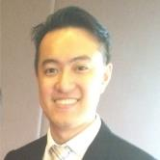













Summary
Problem
Solution
Go To Market
Competition
Financials
The Team
Appendix
The Approvi team has diverse experience in technology startups, finance, compliance, and consulting and are currently pursuing MBAs at the Hong Kong University of Science and Technology
CEO – Phillip Bonarigo
Finance & Strategy Manager in high-growth companies and startups; growth hacker and international businessman
COO – Puranjay Mahapatra
Management Consultant and Project Manager advising on FinTech and Digital Transformation Strategy.
CTO – Daniel Tsai
Data Strategist and Country Manager in Computer Hardware Industry. Coding in Solidity, Python, and Ruby on Rails.
Chief Revenue Officer – Julien Hamonic
Management Consultant and Digital Transformation Professional. Julien holds a Law Degree and has worked in top French banks.
Head of Sales– Deepika Solanki
Corporate Strategy Manager and Management Consultant with strong experience in Growth Strategy and Marketing Analytics.
CFO – FiFi Lu
FiFi is a trained actuary with experience tackling the most complicated financial topics in finance and insurance.

Slide 27
Approvi
Expenses, Done Right.
Appendix

Slide 28
Summary
Problem
Solution
Go To Market
Competition
Financials
The Team
Appendix
Appendix - I
Financials

Slide 29
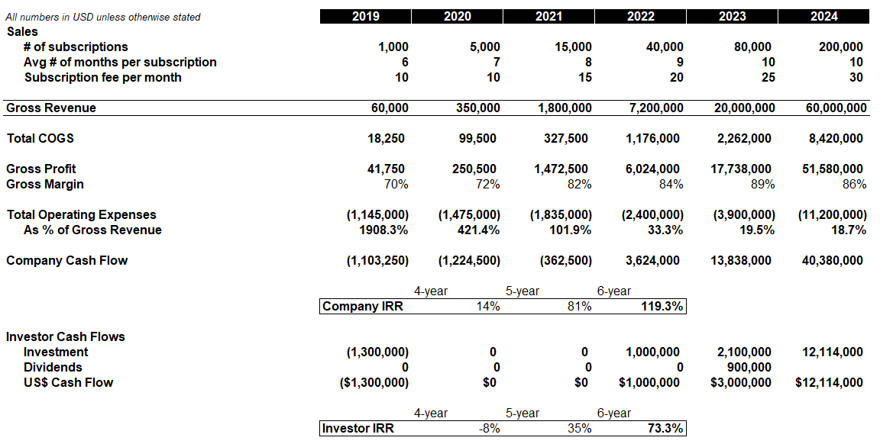
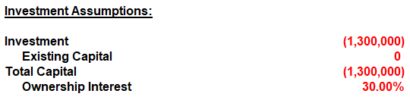
Summary
Problem
Solution
How It Works
Go To Market
Financials
The Team
Appendix
Appendix - I
Financials – Consolidated with Investor Detail
Approvi offers investors a 30% stake in the company for $1.3M, and is projecting positive cash flow to sustain operations after the first year.
This represents an investor IRR of 73% over six years.

Slide 30
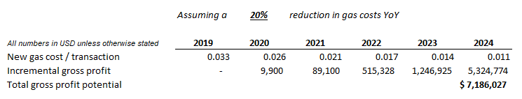
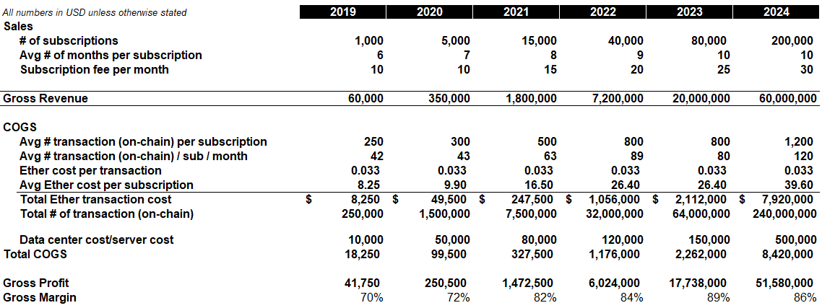
Summary
Problem
Solution
Go To Market
Competition
Financials
The Team
Appendix
Appendix - I
Financials – Revenue & Gross Margin Detail
Note: we have assumed a flat gas cost per transaction of $0.033, which is likely quite conservative.
We should note that a 20% reduction in gas costs from 2020 onward would yield over $7M in additional profit.

Slide 31
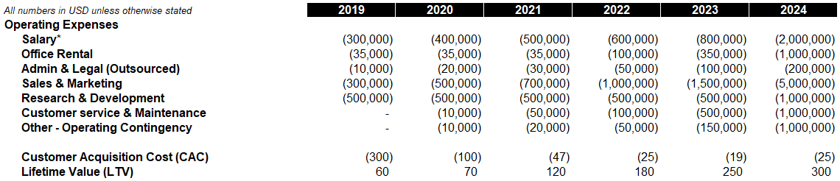
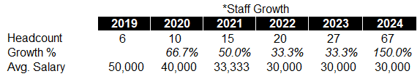
Summary
Problem
Solution
Go To Market
Competition
Financials
The Team
Appendix
Appendix - I
Financials – Operating Expenses, CAC & LTV, Headcount Detail
Our FTE assumptions include employees specifically in R&D functions in both mainland China and Eastern Europe, where talent is plentiful and wages are low relative to other regions.

Slide 32
Summary
Problem
Solution
Go To Market
Competition
Financials
The Team
Appendix
Appendix - II
Product/UX/UI

Slide 33
Summary
Problem
Solution
Go To Market
Competition
Financials
The Team
Appendix
Appendix - II
User Interface

Slide 34
Summary
Problem
Solution
Go To Market
Competition
Financials
The Team
Appendix
Appendix - II
User Interface

Slide 35
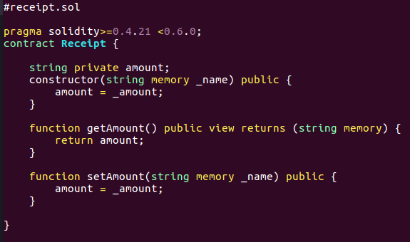
Summary
Problem
Solution
Go To Market
Competition
Financials
The Team
Appendix
Appendix - II
Sample Code & Github
https://github.com/danieltsaicw/approvico
Smart Contract

Slide 36
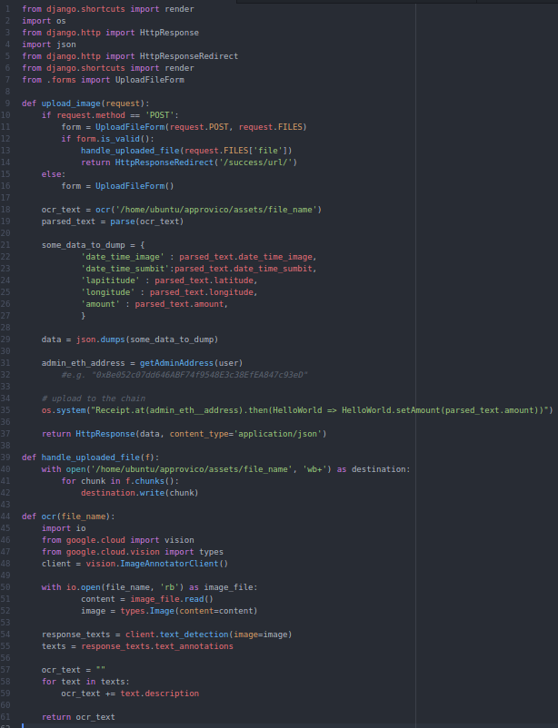
Summary
Problem
Solution
Go To Market
Competition
Financials
The Team
Appendix
Appendix - II
Sample Code & Github
https://github.com/danieltsaicw/approvico

Slide 37
Summary
Problem
Solution
Go To Market
Competition
Financials
The Team
Appendix
Appendix - III
Supplementary Information

Slide 38
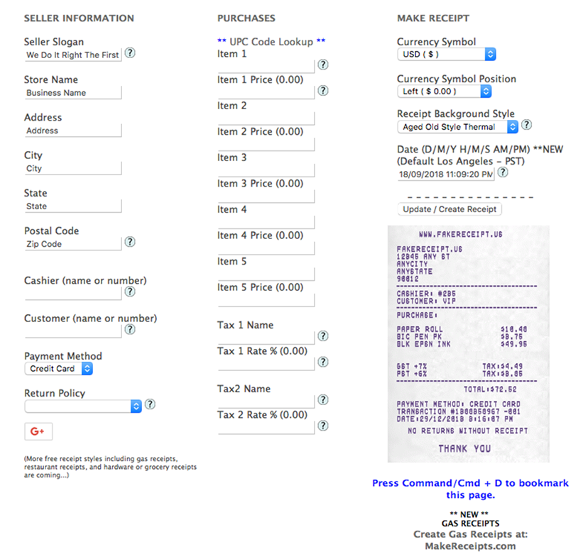
Summary
Problem
Solution
Go To Market
Competition
Financials
The Team
Appendix
Supplementary Information
Fraudulent Receipt Example
Risks of Fraud in the expense processes harm all companies and organizations, and have a direct negative impact on the cost and quality of their products and services.
Each year, expense fraud costs US businesses almost $3 billion according to the Association of Certified Fraud Examiners (median amount is $40,000).
It’s among the hardest types of fraud to detect—nearly impossible without expense software designed to analyze patterns—and afflicts every kind of organization, from small businesses to regulated behemoths.

Slide 39


Summary
Problem
Solution
Go To Market
Competition
Financials
The Team
Appendix
Market surveys show that the majority of businesses still use manual expense management processes
Web based
37%
Outdated systems take their toll from employees (survey of 500 employees with accounts payables from small to large companies)
Any process that use Excel spreadsheets, pen & paper, or homegrown systems
Manual
46%
ERP
17%
Manual process use
64%
20%
Source: T&E Management Infographics | Certify
certify.com
Small businesses
(<100 employees)
Large companies
(100+ employees)

Slide 40

Summary
Problem
Solution
Go To Market
Competition
Financials
The Team
Appendix
Bringing Radical Trust & Transparency to Expenses

